Slide 1
The long shadow of persistent poverty
Oliver Anderson¹, Claire Crawford¹, Andy Dickerson² and Steve McIntosh²
1 University College London
2 University of Sheffield
NCRM Webinar
June 2024
CENTRE FOR EDUCATION POLICY & EQUALISING OPPORTUNITIES

Slide 2
Motivation
Vast literature highlighting gaps in education outcomes between individuals from different backgrounds; more limited literature on labour market gaps
But in many cases groups are quite coarse, especially when using admin data
  e.g. eligible for free school meals vs. not
New admin data means we can now track individuals through education and into the labour market and capture FSM eligibility at different points in time
Explore variation in education and early labour market trajectories (to age 23) for those eligible for free school meals for different numbers of years using Longitudinal Education Outcomes (LEO) data for England

Slide 3
Longitudinal Education Outcomes (LEO) data
Combines education and labour market records for those who’ve interacted with the English school or further education system since 2001-02 (primarily born since 1985-86)
  School records from the National Pupil Database (NPD) including demographic characteristics (e.g. FSM eligibility) and measures of attainment (from 2001-02)
  Further education records from the Individualised Learner Records (ILR) (from 2002-03)
  Higher education records from the Higher Education Statistics Agency (now Jisc) (from 2004-05)
    And more recently university applications from the Universities and Colleges Admissions Service (UCAS)

Slide 4
Longitudinal Education Outcomes (LEO) data
Combines education and labour market records for those who’ve interacted with the English school or further education system since 2001-02 (primarily born since 1985-86)
  Tax records from His Majesty’s Revenue and Customs
    PAYE from 2003-04, including employment spells and annual earnings (and more recently industry; no hours)
    Self-assessment data from 2014-15, including annual income/profits
  Out-of-work benefit data (type, spells) from Department for Work and Pensions (from 2003-04)

Slide 5
Sample selection
We focus on the cohort who took GCSEs (age 16) in 2011/12
Chosen because:
  We can observe FSM eligibility from Years 1-11
  We can follow individuals up to age 23 (in 2018-19, pre-pandemic)
We focus on individuals with a complete FSM history (around 450,000)
We split the sample according to the number of years of FSM eligibility
Those with zero years of FSM eligibility: split into quartiles using very local neighbourhood measures of SES (e.g. Chowdry et al., 2013)
Chowdry, H. C. Crawford, L. Dearden, A. Goodman and A. Vignoles (2013), Widening participation in higher education: analysis using linked administrative data, Journal of the Royal Statistical Society: Series A, Vol. 176, pp. 431-457

Slide 6
Variation in FSM eligibility during school career
No. of years eligible in primary school | Number of years eligible in secondary school
 | 0 years | 1 or 2 | 3 or 4 | 5 years | Total
0 years | 70.08% | 2.50% | 1.15% | 0.27% | 74.00%
1 or 2 | 4.64% | 1.57% | 1.06% | 0.66% | 7.93%
3 or 4 | 2.45% | 1.44% | 1.35% | 1.16% | 6.40%
5 or 6 | 1.20% | 2.07% | 3.28% | 5.13% | 11.67%
Total | 78.36% | 7.58% | 6.85% | 7.22% | 100.00%

Slide 7
Variation in FSM eligibility during school career
No. of years eligible in primary school | Number of years eligible in secondary school
 | 0 years | 1 or 2 | 3 or 4 | 5 years | Total
0 years | 70.08% | 2.50% | 1.15% | 0.27% | 74.00%
1 or 2 | 4.64% | 1.57% | 1.06% | 0.66% | 7.93%
3 or 4 | 2.45% | 1.44% | 1.35% | 1.16% | 6.40%
5 or 6 | 1.20% | 2.07% | 3.28% | 5.13% | 11.67%
Total | 78.36% | 7.58% | 6.85% | 7.22% | 100.00%

Slide 8
Variation in FSM eligibility during school career
No. of years eligible in primary school | Number of years eligible in secondary school
 | 0 years | 1 or 2 | 3 or 4 | 5 years | Total
0 years | 70.08% | 2.50% | 1.15% | 0.27% | 74.00%
1 or 2 | 4.64% | 1.57% | 1.06% | 0.66% | 7.93%
3 or 4 | 2.45% | 1.44% | 1.35% | 1.16% | 6.40%
5 or 6 | 1.20% | 2.07% | 3.28% | 5.13% | 11.67%
Total | 78.36% | 7.58% | 6.85% | 7.22% | 100.00%

Slide 9
Outcomes of interest
We are interested in characterising individuals’ trajectories through post-compulsory education and into the labour market, so we classify individuals according to their activities in each six monthly period between ages 17 and 23
  In below L2 education
  In L2 academic or vocational education with or without 15 states
  In L3 academic or vocational education also being in work across 14 periods
  In L4 or above education
  Employed
  Out of work benefits
  No activity
Plus daily earnings

Slide 10
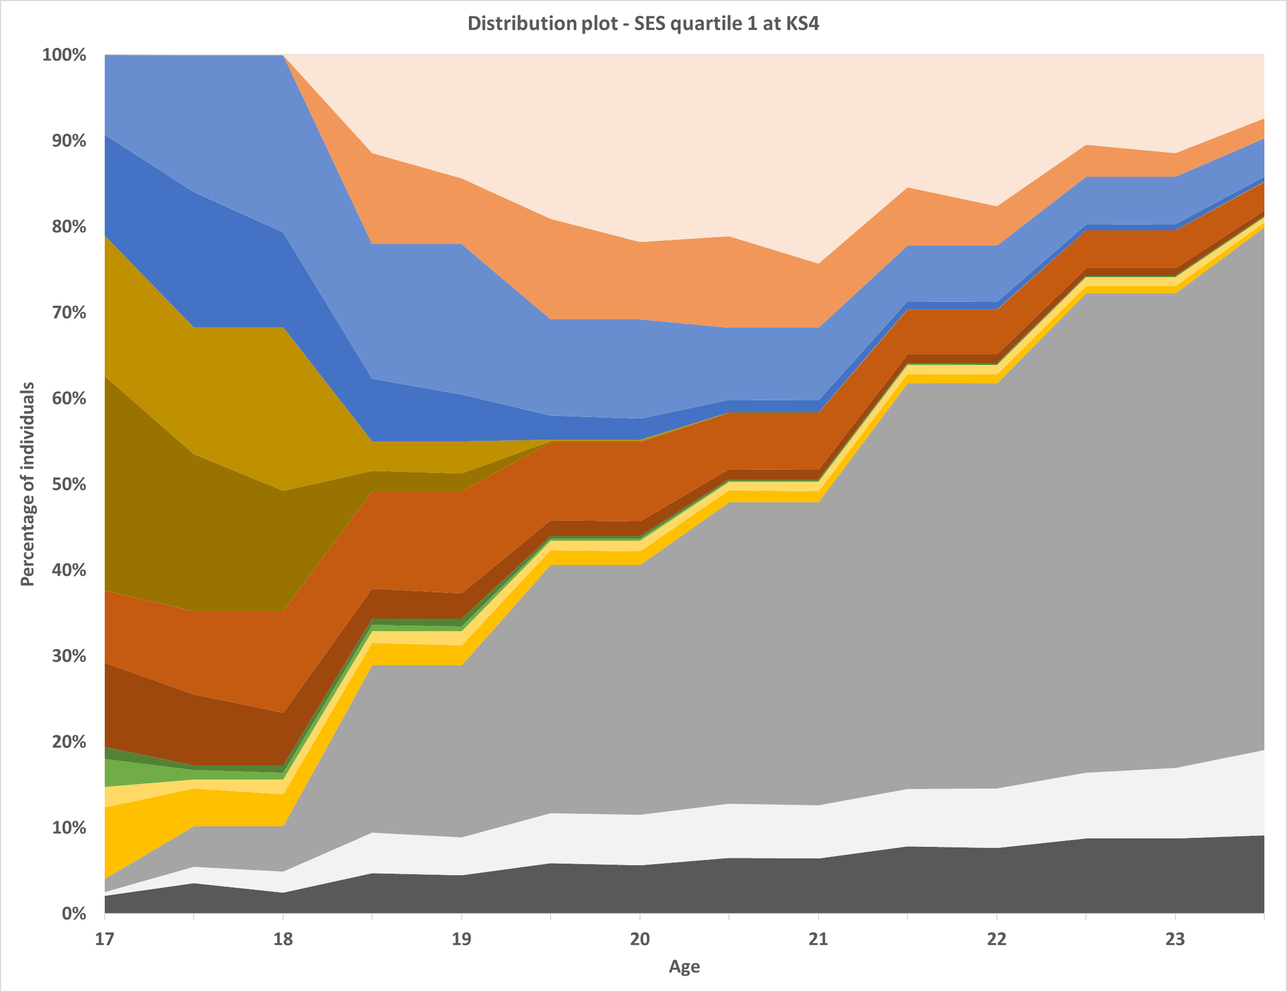
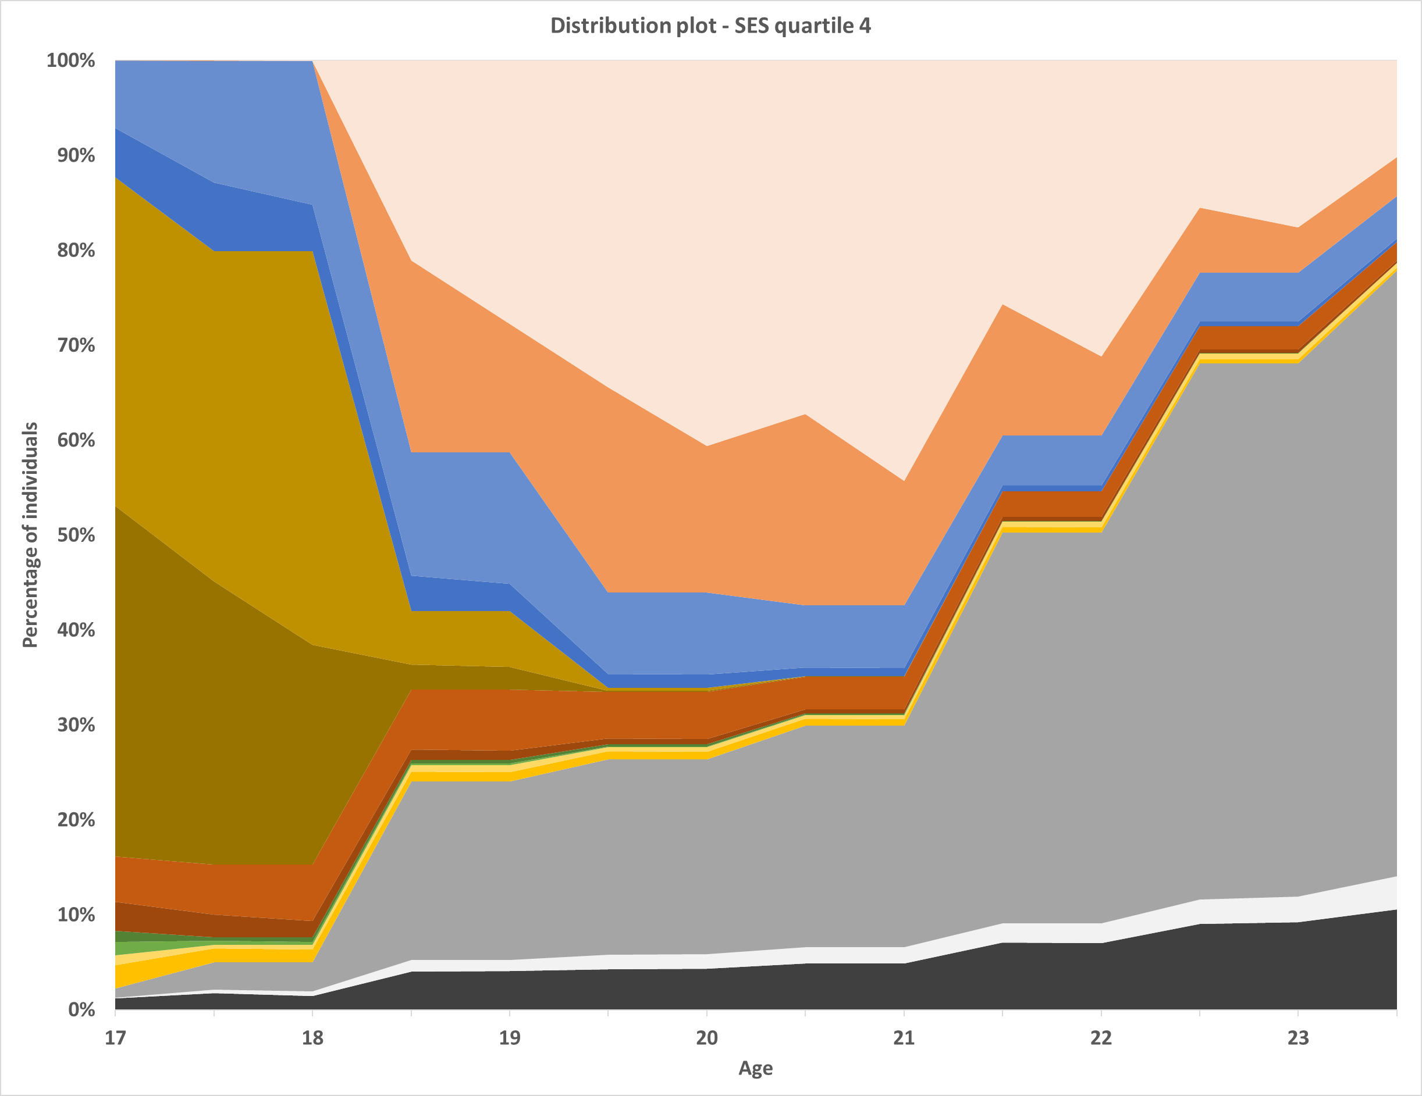
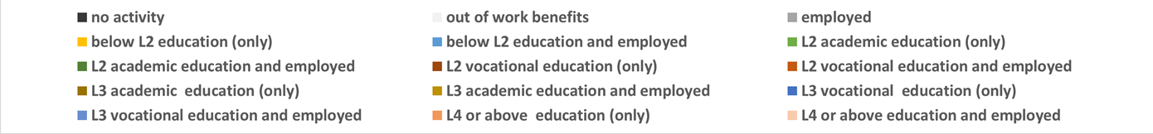
SES quartile 1 (lowest non-FSM)
SES quartile 4 (highest non-FSM)
Notes:
Darker colours – education only; light colours – education and work

Slide 11
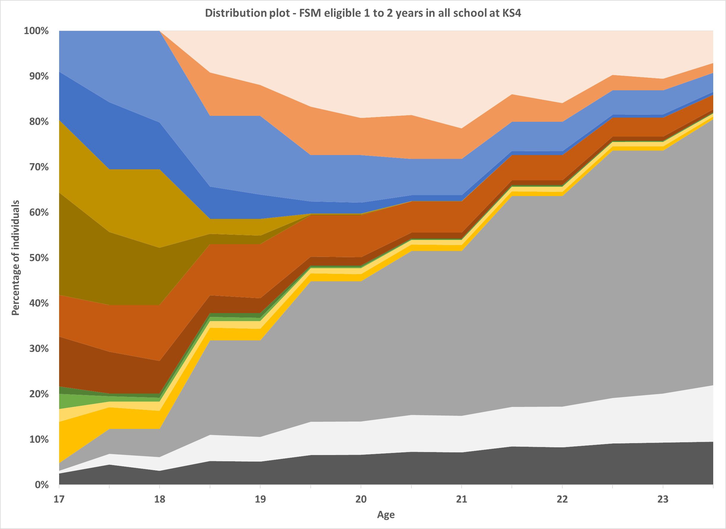
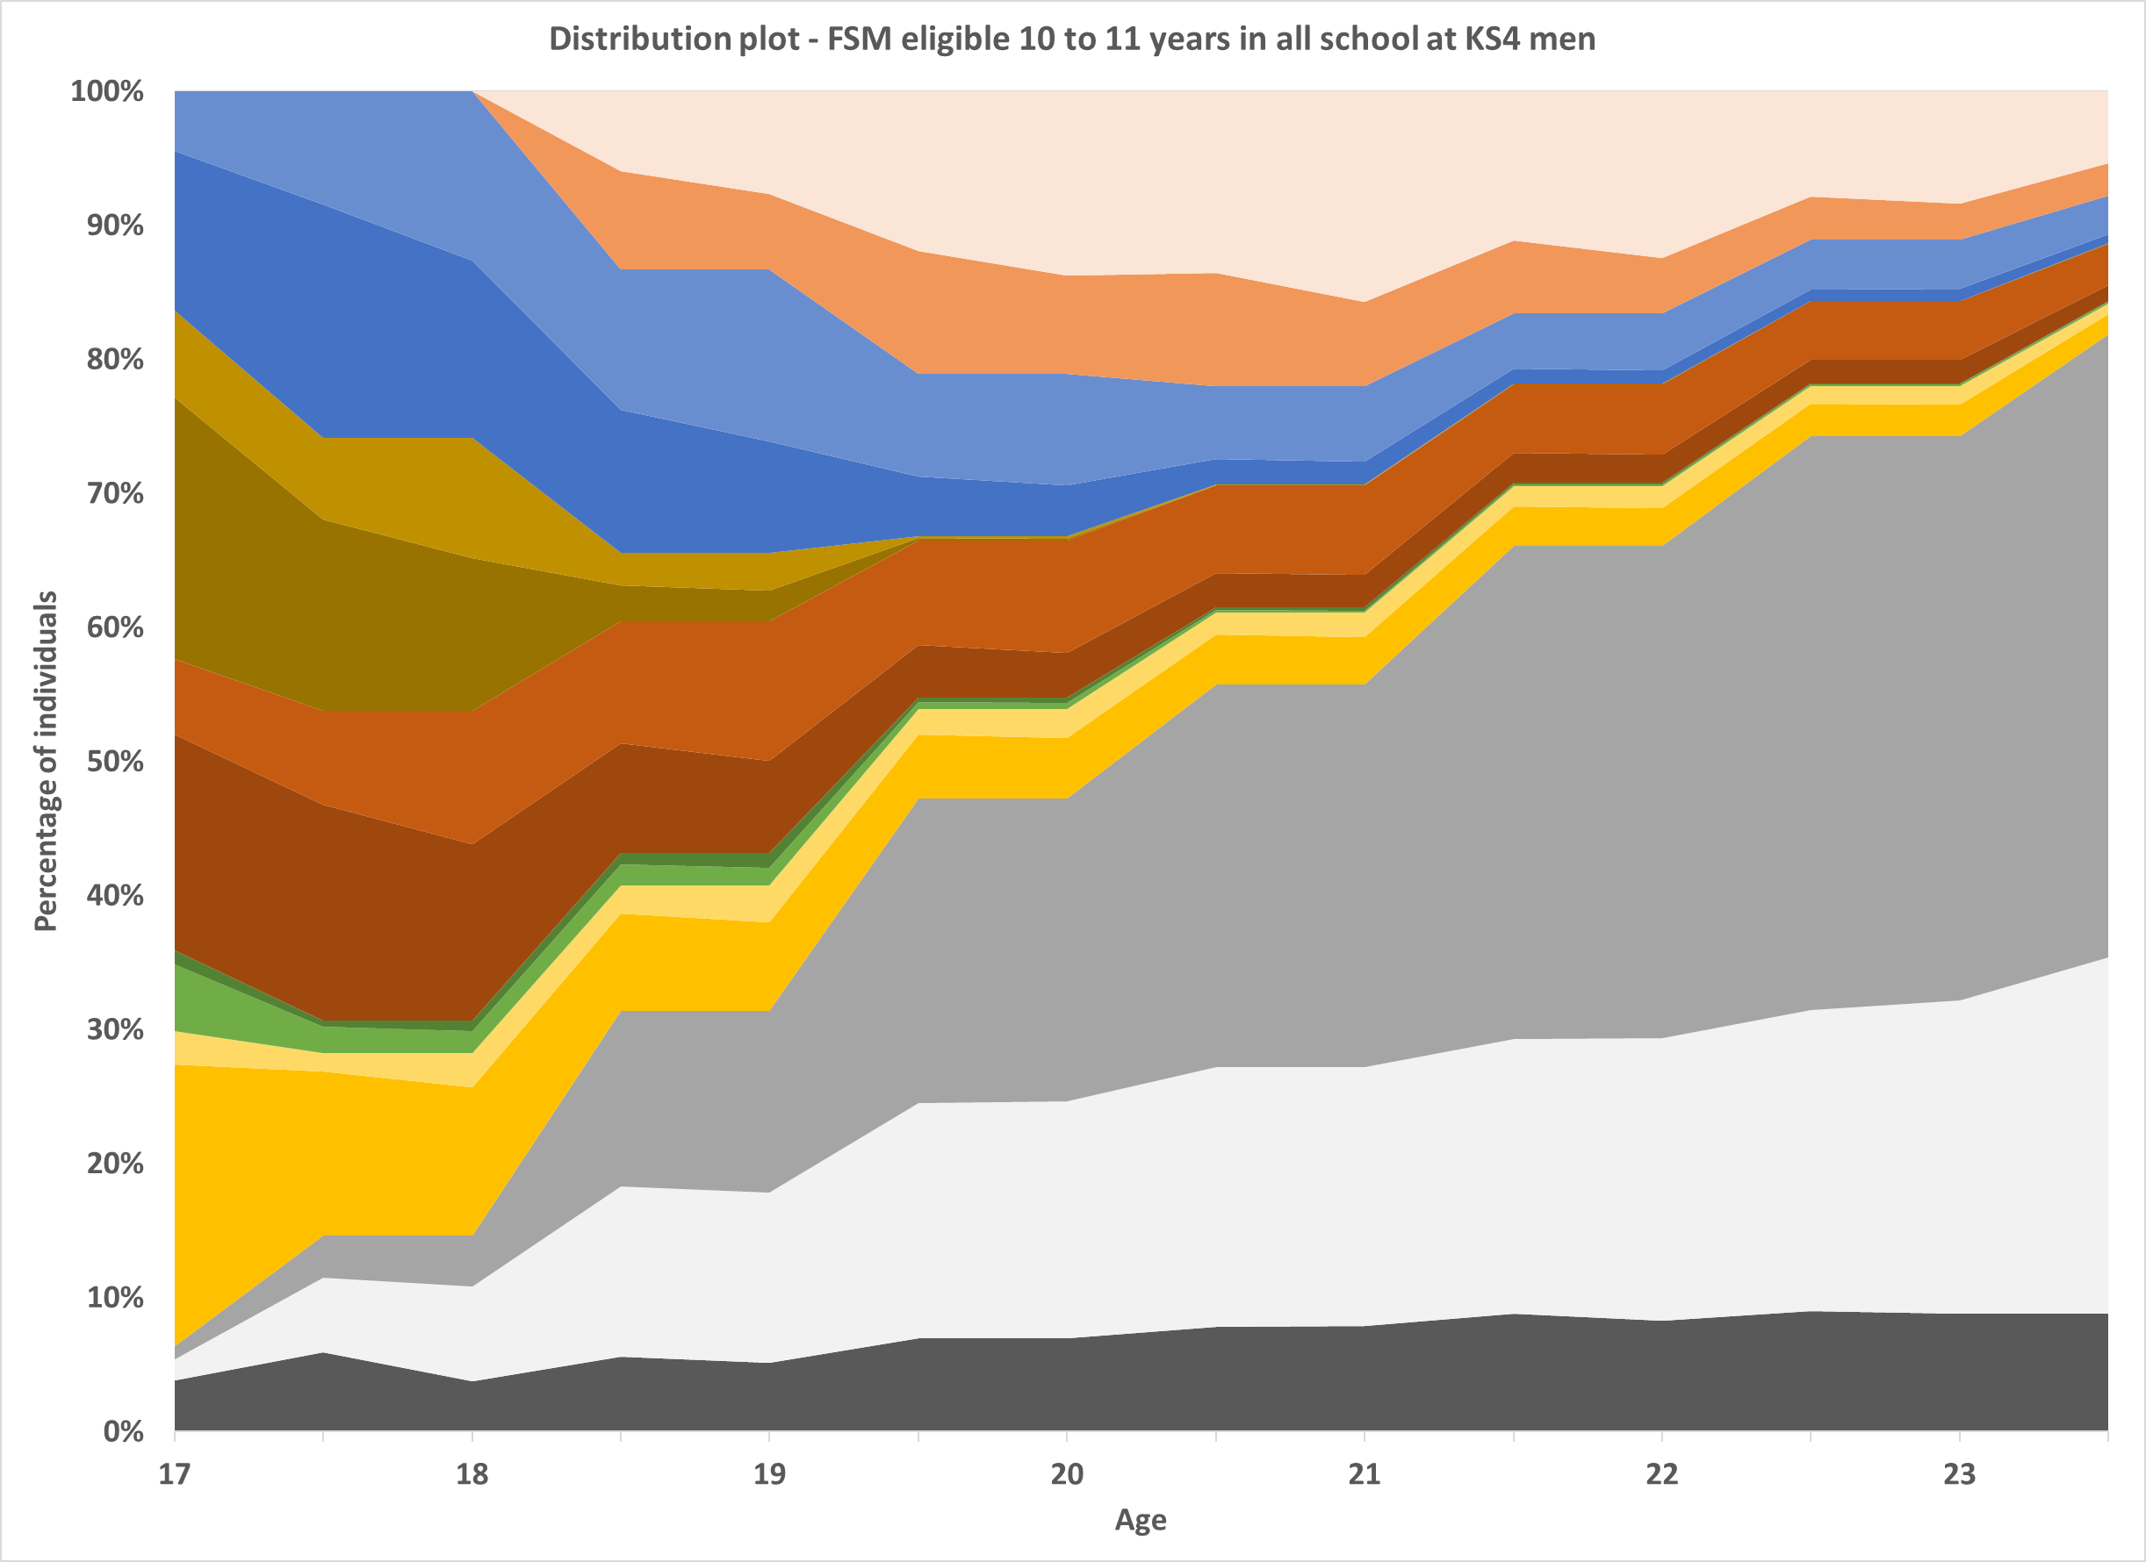
1-2 years FSM eligibility
10-11 years FSM eligibility
Notes:
Darker colours – education only; light colours – education and work

Slide 12
Summarising trajectories
Cluster number | Cluster name
1 | Routes to no activity
2 | Benefits dependency
3 | Vocational ed to employment (slow)
4 | Quickly to employment (vocational)
5 | Higher education slow
6 | A-levels, degree, job – working whilst studying
7 | A-levels, degree, job – not working whilst studying

Slide 13
Differences in earnings at age 25 by socio-economic status

Slide 14
Summary
Monotonic relationship between number of years of FSM eligibility and later outcomes
  A significant ‘gap within the gap’ in terms of education and labour market trajectories
Next steps:
  Exploration of persistent vs. transitory FSM eligibility and ages being experienced
  Mediation analysis exploring how much of the variation in wages can be explained by different parts of (or the whole) prior education and labour market trajectory

Slide 15
Resources
Find out more about the LEO data: https://www.gov.uk/government/publications/longitudinal-education-outcomes-leo-dataset/longitudinal-education-outcomes-leo-data
How to access the LEO data: https://www.gov.uk/guidance/apply-to-access-the-longitudinal-education-outcomes-leo-dataset
Collection of DfE funded/produced reports using LEO data: https://www.gov.uk/government/collections/longitudinal-education-outcomes-leo-collection
LEO post-16 education and labour market trajectories dashboard (forerunner to our work): https://department-for-education.shinyapps.io/leo-post16education-labourmarket/
LEO graduate industry dashboard: https://department-for-education.shinyapps.io/leo-graduate-industry-dashboard/

